Slide 2
A Loving People
Philippians 1:9-10 And this I pray, that your love may abound still more and more in knowledge and all discernment, 10 that you may approve the things that are excellent, that you may be sincere and without offense till the day of Christ.

Slide 3
A Loving People
Agape
love I show to you regardless what you think, do and your mind-set (attention, action and attitude)
Agape
Unconditional love

Slide 4
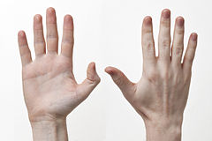
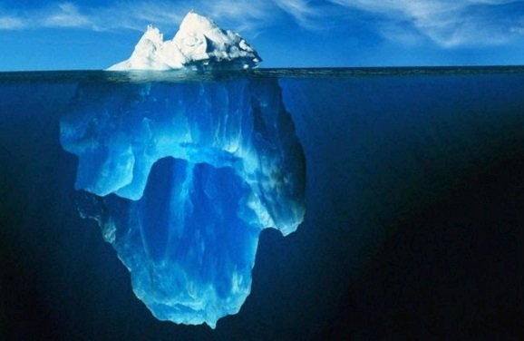
Attention
Action
Attitude

Slide 5
Attention
A Loving People
Agape love requires a purposeful decision

Slide 6
Attention
A Loving People
Luke 10:27
So he answered and said, “ ‘You shall love the Lord your God with all your heart, with all your soul, with all your strength, and with all your mind, and your neighbor as yourself.

Slide 7
Attention
A Loving People
John 13:35
By this all will know that you are My disciples, if you have love for one another.

Slide 8
Action
A Loving People
Agape love can not be invisible

Slide 9
Action
A Loving People
1 Corinthians 3:6
I planted, Apollos watered, but God gave the increase.

Slide 10
Action
A Loving People
John 13:34-35
34 A new commandment I give to you, that you love one another; as I have loved you, that you also love one another. 35 By this all will know that you are My disciples, if you have love for one another.”

Slide 11
Action
A Loving People
Matthew 18:15-19

Slide 12
Attitude
A Loving People
What motivates your agape love?

Slide 13
Attitude
A Loving People
Romans 12:20
20 Therefore
“If your enemy is hungry, feed him;
If he is thirsty, give him a drink;
For in so doing you will heap coals of fire on his head.

Slide 14
Attitude
A Loving People
Proverbs 25:21-22
21 If your enemy is hungry, give him bread to eat;
And if he is thirsty, give him water to drink;
22 For so you will heap coals of fire on his head,
And the Lord will reward you.

Slide 15
Attitude
A Loving People
Mark 12:30
30 And you shall love the Lord your God with all your heart, with all your soul, with all your mind, and with all your strength.’ This is the first commandment.

Slide 16
Conclusion
A Loving People
1 John 4:19
We love Him because He first loved us.

